Slide 1

Facial Expression Recognition using Convolutional Neural Network
Research Project

Slide 2
Contents
Introduction
Objective
Dataset
Methods and Implementation
Results
Conclusion
Outlook

Slide 3
Contents
Introduction
Objective
Dataset
Methods and Implementation
Results
Conclusion
Outlook

Slide 4
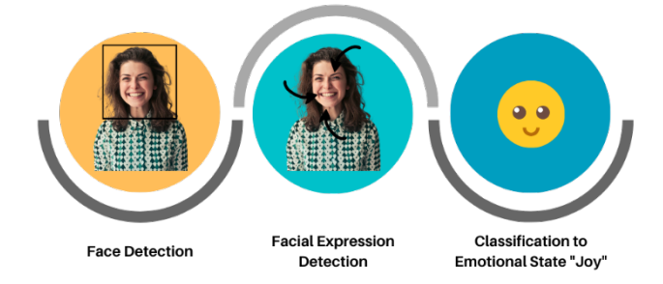
Introduction
Facial Emotion Recognition (FER) - detect and interpret a person's emotional state through facial expressions.
Applications of FER:
Enhancing Human-computer interaction
Assisting in mental health diagnosis and treatment
Improving marketing and advertising strategies
Facilitating social interactions
Aiding law enforcement and security
Source: K. Vemou and A. Horvath, “Techdispatch 1/2021 - facial emotion recognition.” https://edps.europa.eu/data-protection/our-work/publications/ techdispatch/techdispatch-12021-facial-emotion-recognition_en, 2021.

Slide 5
Contents
Introduction
Objective
Dataset
Methods and Implementation
Results
Conclusion
Outlook

Slide 6

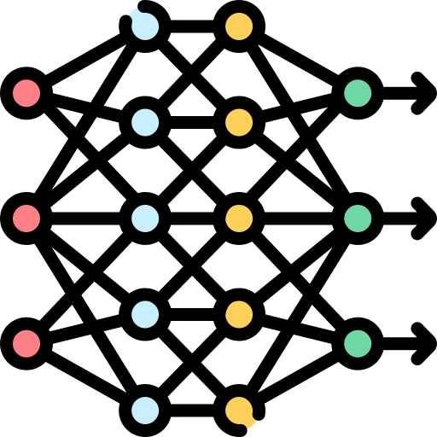


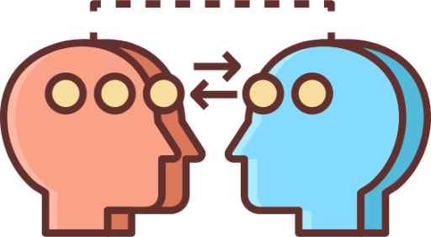


Objective
Develop a deep learning architecture for FER - can be used in real-time applications on low-resource devices
Investigate the effects of data augmentation and hyperparameter tuning on the performance of the FER model
Transfer learning - by adapting and fine-tuning a pre-trained model for the task of FER
Deploy the model in a real-time environment - build a practical system for real-time FER

Slide 7
Contents
Introduction
Objective
Dataset
Methods and Implementation
Results
Conclusion
Outlook

Slide 8
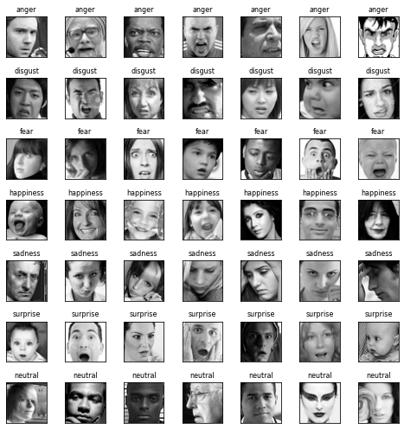
Dataset
FER 2013 dataset
7-emotions :
Anger
Disgust
Fear
Happiness
Sadness
Surprise
Neutral

Slide 9
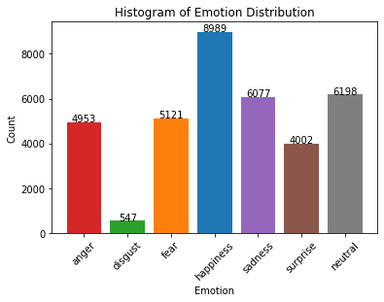
Dataset
35887 , 48x48 pixel gray scale images
Emotion | # of samples
Angry | 4953
Disgust | 547
Fear | 5121
Happiness | 8989
Sadness | 6077
Surprise | 4002
Neutral | 6198

Slide 10
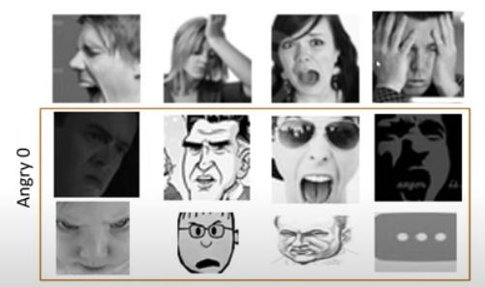
Problems in Dataset
Imbalance problem
Intra-class variation problem
Occlusion & Eyeglasses
Contrast variation
Outliers

Slide 11
Contents
Introduction
Objective
Dataset
Methods and Implementation
Results
Conclusion
Outlook

Slide 12
Methods and Implementation
1
Data Preprocessing
2
Architecture Design
Data Augmentation Hyperparameter Tuning
3
4
Transfer Learning
5
Real Time FER
6
Model Evaluation and Metrics

Slide 13
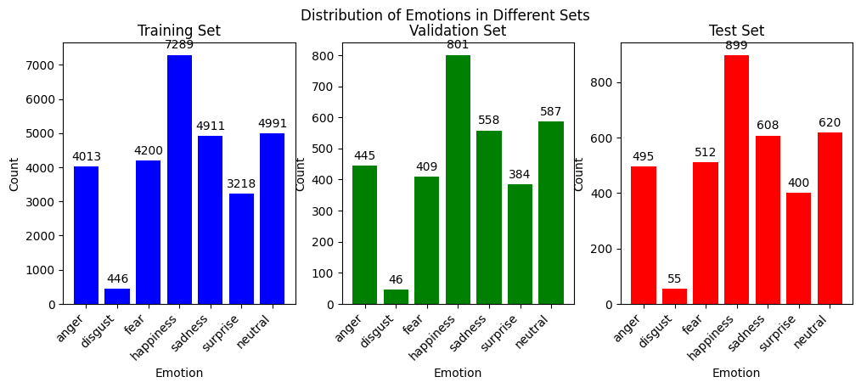
Data Preprocessing
Train-Test and validation split
Shuffling
Normalization → range (0,1)
One-hot encoding
Emotion | One-Hot Encoding
Anger | [1, 0, 0, 0, 0, 0, 0]
Disgust | [0, 1, 0, 0, 0, 0, 0]
Fear | [0, 0, 1, 0, 0, 0, 0]
Happy | [0, 0, 0, 1, 0, 0, 0]
Sad | [0, 0, 0, 0, 1, 0, 0]
Surprise | [0, 0, 0, 0, 0, 1, 0]
Neutral | [0, 0, 0, 0, 0, 0, 1]

Slide 14
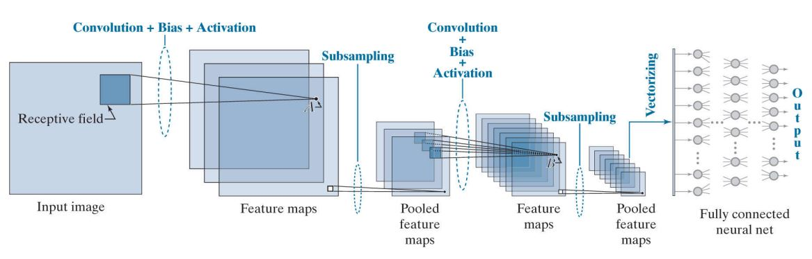
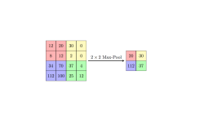
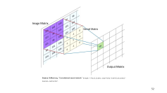
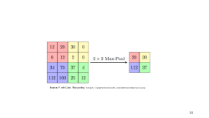
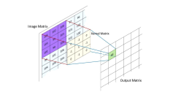
Convolutional Neural Network
Source: R. C. Gonzalez and R. E. Woods, Digital Image Processing. Upper Saddle River, NJ:Prentice Hall, 4th ed., 2018.

Slide 15
Shallow CNN
Number of classes: 7
Network structure: 3 Conv 2D block, 1 FC, 1 Output
Activation function: ReLU , Softmax
Optimizer: Adam
Batch size : 32 , epochs : 100
Learning rate : 0.001
Loss function: Categorical cross - entropy
Early Stopping
Batch normalization and dropout
Shallow CNN
Input (48x48 gray scale image)
CONV2D 3 × 3 × 32, RELU, BATCH NORM
MAXPOOL 2 × 2 , Dropout 0.5
CONV2D 3 × 3 × 64, RELU, BATCH NORM
MAXPOOL 2 × 2 , Dropout 0.5
CONV2D 3 × 3 ×128, RELU, BATCH NORM
MAXPOOL 2 × 2 , Dropout 0.5
FC 64, RELU, BATCH NORM, Dropout 0.5
FC 7 , SOFTMAX

Slide 16
Deep CNN
Deep CNN
Input (48x48 gray scale image)
CONV2D 5 × 5 × 64, ELU, BATCH NORM
CONV2D 5 × 5 × 64, ELU, BATCH NORM
MAXPOOL 2 × 2 , Dropout 0.4
CONV2D 3 × 3 × 128, ELU, BATCH NORM
CONV2D 3 × 3 × 128, ELU, BATCH NORM
MAXPOOL 2 × 2 , Dropout 0.4
CONV2D 3 × 3 × 256, ELU, BATCH NORM
CONV2D 3 × 3 × 256, ELU, BATCH NORM
MAXPOOL 2 × 2 , Dropout 0.5
FC 128, ELU, BATCH NORM, Dropout 0.6
FC 7 , SOFTMAX
Number of classes: 7
Network structure: 6 Conv 2D block, 1 FC, 1 Output
Activation function: ELU
Optimizer: Nadam ​
Batch size : 32 , epoch : 100
Learning rate : 0.001
Early stopping
Loss function: Categorical Cross - Entropy
Batch normalization and dropout is used as the regularization.

Slide 17
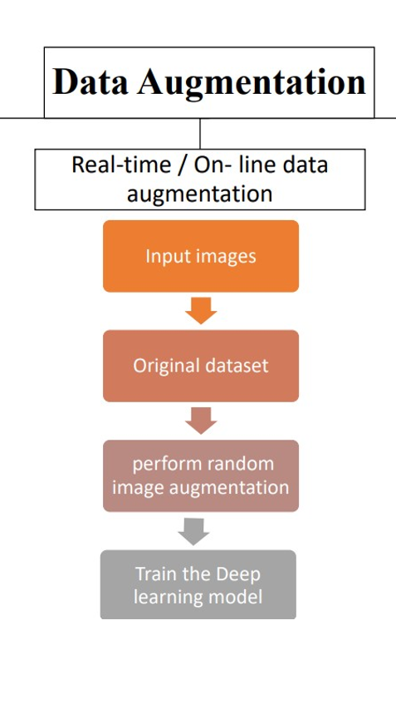
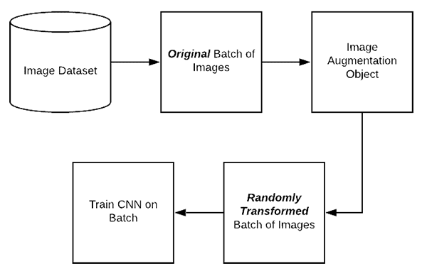
Data Augmentation
Online / on the fly data augmentation
Step 1: An input batch of images is presented to the Imagedatagenerator
Step 2: Imagedatagenerator transforms each image in the batch by a series of random translations, rotations, etc.
Step 3: The randomly transformed batch is then returned to the calling function.
Source: K. Malialis, D. Papatheodoulou, S. Filippou, C. G. Panayiotou, and M. M. Polycarpou, “Data augmentation on-the-fly and active learning in data stream classification,” arXiv preprint arXiv:2210.06873, 2022.

Slide 18
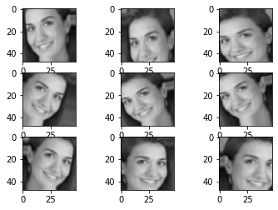
Data Augmentation
Keras API - Imagedatagenerator
train_datagen =ImageDataGenerator
(rotation_range=15,
width_shift_range=0.15,
height_shift_range=0.15,
shear_range=0.15,
zoom_range=0.15,
horizontal_flip=True)
train_datagen.fit(X_train)

Slide 19
Hyperparameter Tuning
Finding the best learning rate : Keras API - callback ReduceLROnPlateau : monitor validation accuracy and reduce the learning rate if it fails to improve after a specified number of epochs
Learning rate scheduler - decrease learning rate by specified factor =0.5 if no improvement in validation accuracy for seven consecutive epochs. Minimum learning rate set at 1e - 7

Slide 20
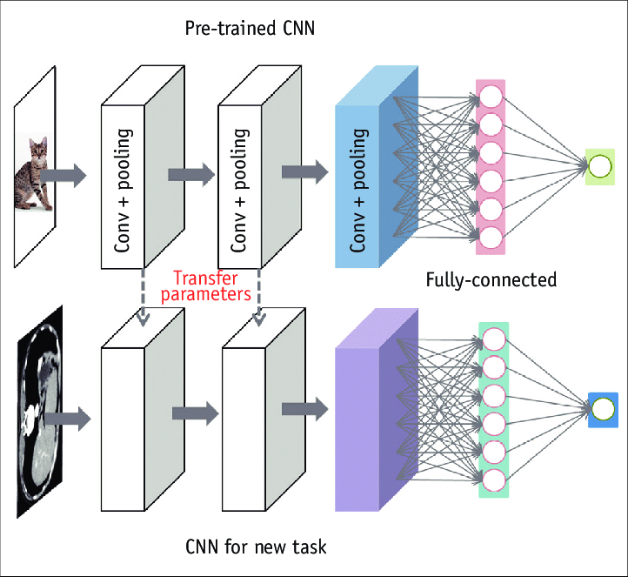
Transfer Learning
Source: Do, Synho et al. “Basics of Deep Learning: A Radiologist's Guide to Understanding Published Radiology Articles on Deep Learning.” Korean journal of radiology vol. 21,1 (2020): 33-41. doi:10.3348/kjr.2019.0312

Slide 21
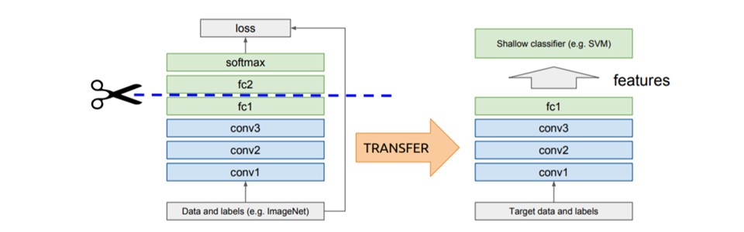
Idea of Transfer Learning
IDEA – Use outputs of one or more layers of a network trained on a different task as generic
feature detectors. Train a new model on these features
Source: “What Is Transfer Learning? [Examples & Newbie-Friendly Guide].” V7labs.com, 2022, www.v7labs.com/blog/transfer-learning-guide.
‌

Slide 22
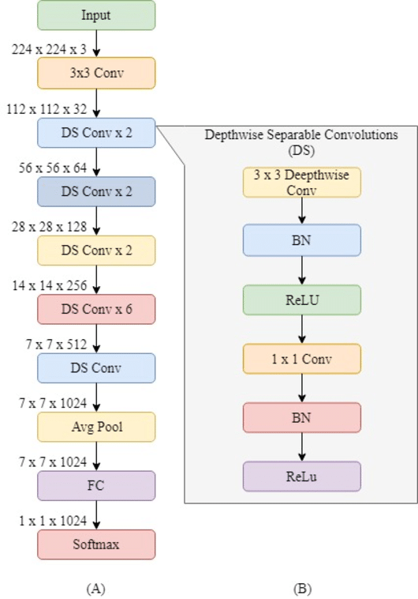
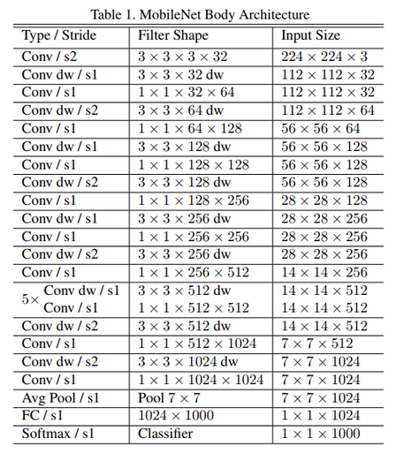
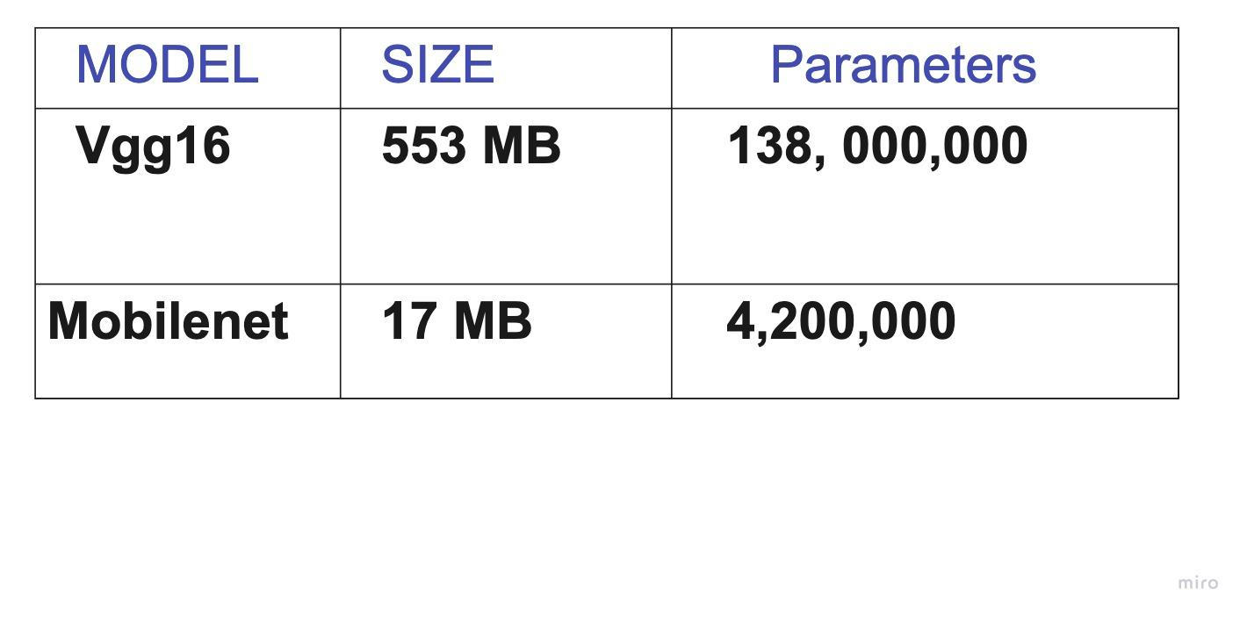
MobileNet
Source: A. G. Howard, M. Zhu, B. Chen, D. Kalenichenko, W. Wang, T. Weyand, M. Andreetto, and H. Adam, “Mobilenets: Efficient convolutional neural networks for mobile vision applications,” arXiv preprint arXiv:1704.04861, 2017.
Source: Phiphitphatphaisit, Sirawan & Surinta, Olarik. (2020). Food Image Classification with Improved MobileNet Architecture and Data Augmentation.

Slide 23
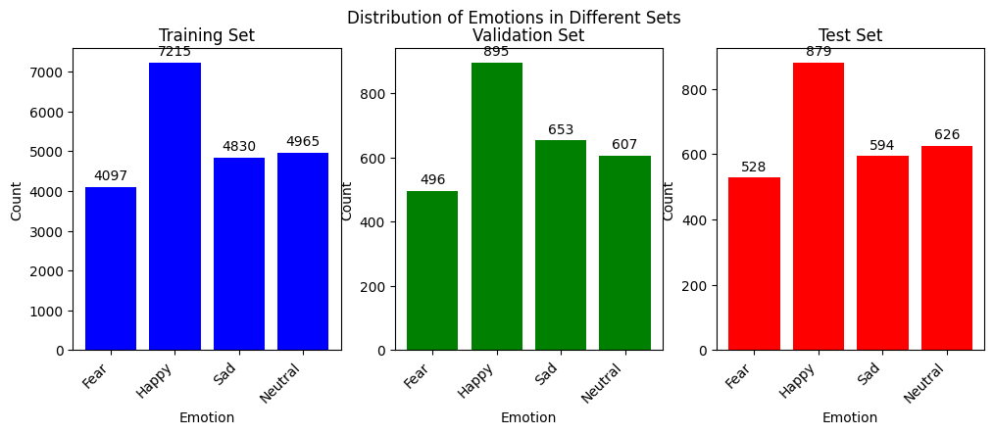
MobileNet
Images are converted to RGB by replicating the same gray scale images along channels
Experiments :
All emotions
Top four emotions

Slide 24
Real Time Emotion Recognition
Live Video
Read a Frame/image
Haar Cascade Classifier
Scan for facial features
N
Face detected?
Y
Extract face image
Convert RGB image to the gray scale
Deep CNN
Emotion Classification
Draw rectangle around face with emotion name

Slide 25

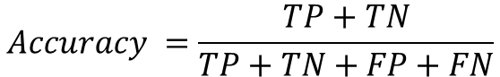
Model Evaluation and Metrics
Loss Curves
Classification outcomes:
True Positives (TP), False Positives (FP), True Negatives (TN), False Negatives (FN)
Confusion Matrix
Accuracy: Ratio of correctly classified instances of all classes to the total number of samples
$$Accuracy =\frac{TP+TN}{TP+TN+FP+FN}$$

Slide 26


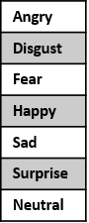
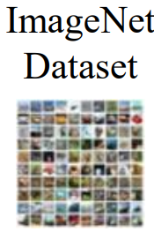
FER-2013 Train
Deep/Shallow CNN
FER-2013 (Test)
Video Frame
ImageDataGenerator
Original Data
Augmented Data
Shallow/ Deep CNN
Training
Trained FER Model
Trained FER Model
Haar Cascade Frontal Face
Face detection & Extraction
Hyperparameter Tuning
Emotion Prediction
Learning Rate Scheduler
Face Image
FER-2013 Train
ImageDataGenerator
Accuracy Evaluation
Original Data
Augmented Data
Best FER Model
Testing
MobileNet
Training
Pre-Trained Network
Fine Tuning
Trained FER Model
Hyperparameter Tuning
Predicted Emotion
Transfer Learning
Learning Rate Scheduler
Real Time

Slide 27
Contents
Introduction
Objective
Dataset and Problems
Methods and Implementation
Results
Conclusion
Outlook

Slide 28
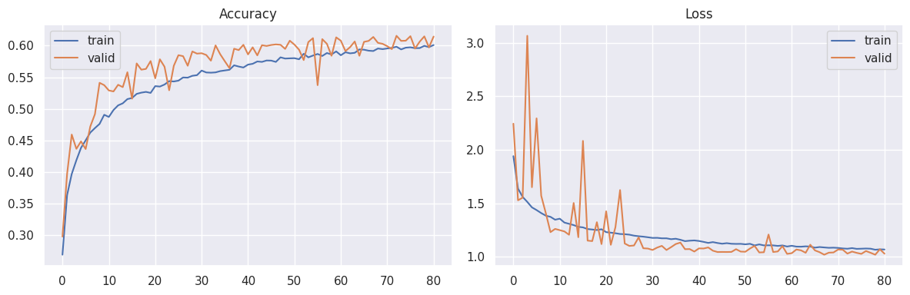
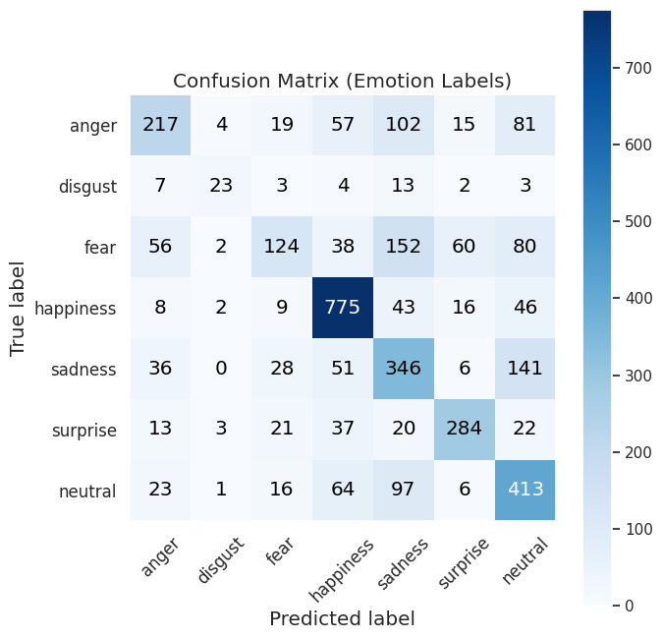
Shallow CNN
Train = 60.09% , Valid = 61.42, Test = 60.8

Slide 29
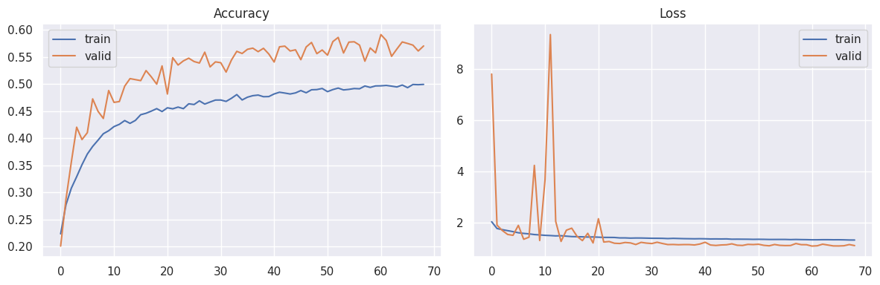
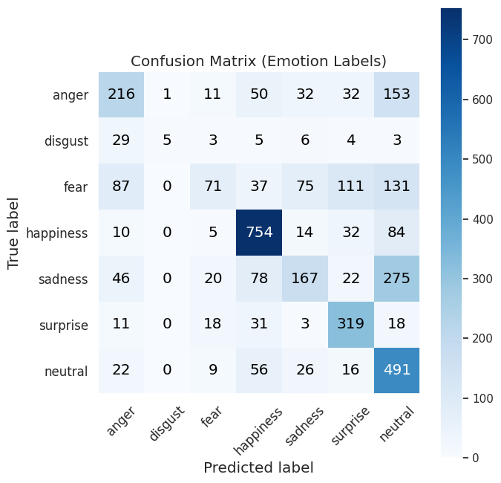
Shallow CNN – Aug
Train = 49.95% , Valid = 57.06, Test = 56.2

Slide 30
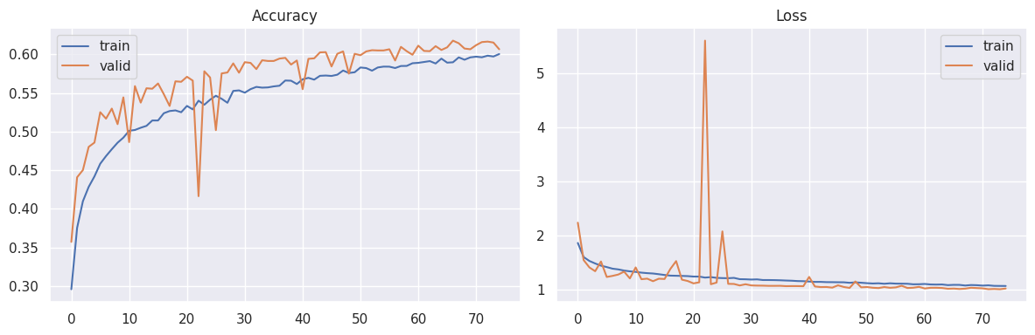
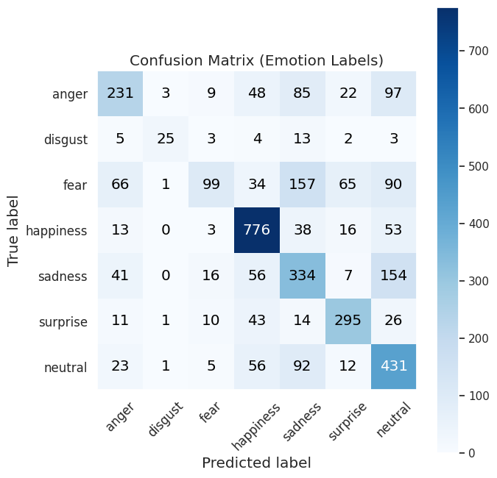
Shallow CNN – HP Tune
Train = 60.03% , Valid = 60.65, Test = 61.1

Slide 31
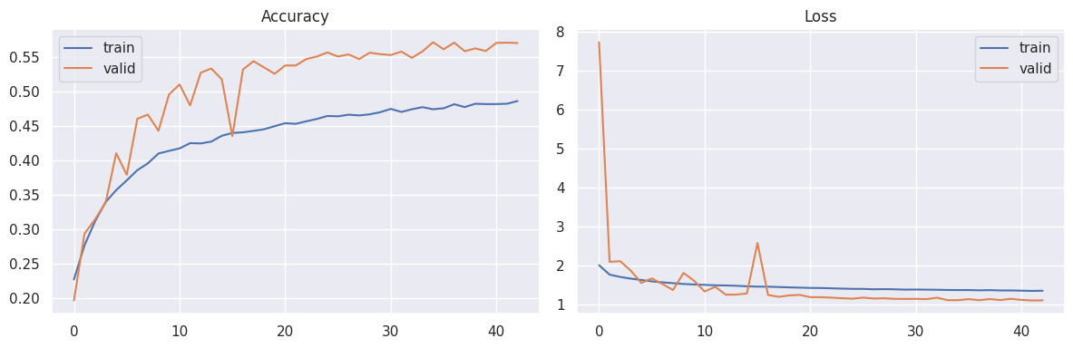
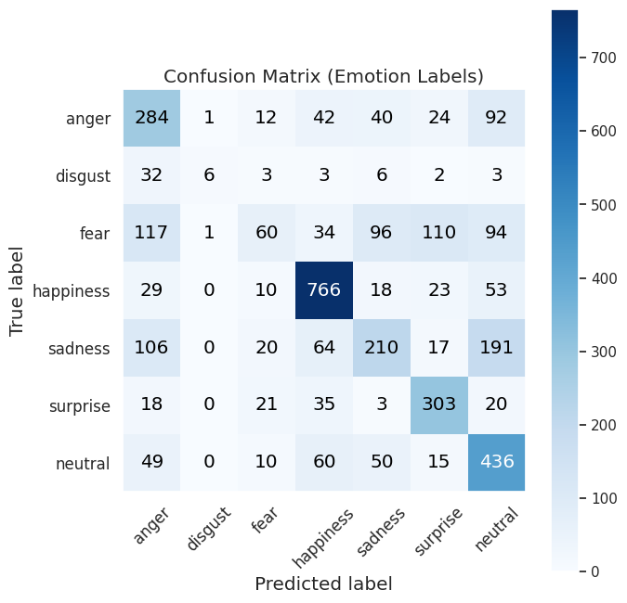
Shallow CNN – Aug + HP Tune
Train = 48.62% , Valid = 57.03%, Test = 57.5%

Slide 32
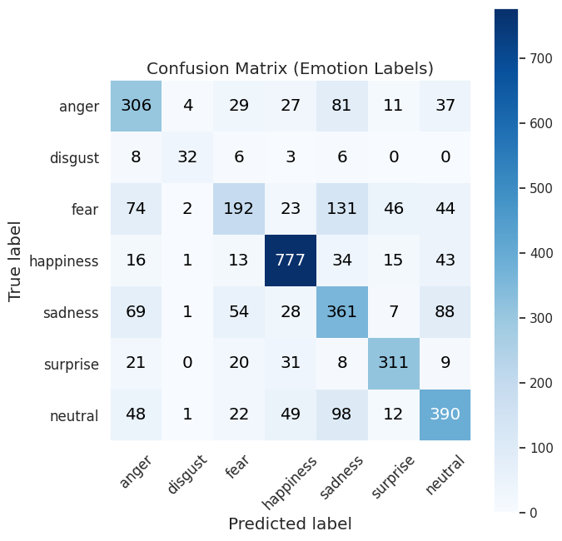
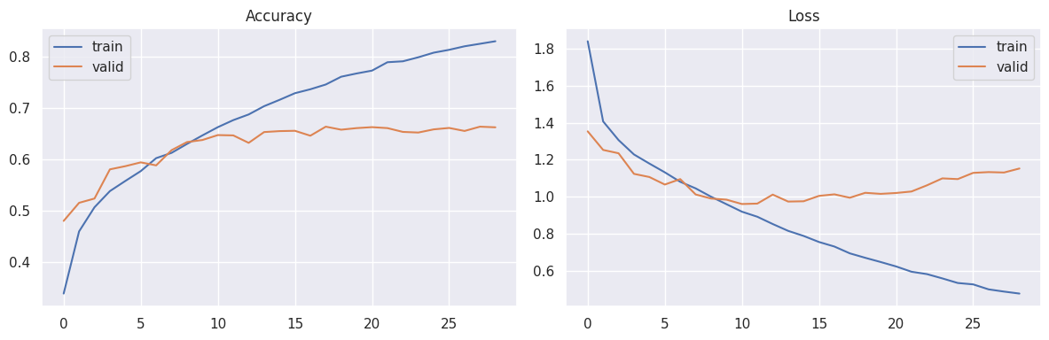
Deep CNN
Train = 82.52% , Valid = 66.22%, Test = 66

Slide 33
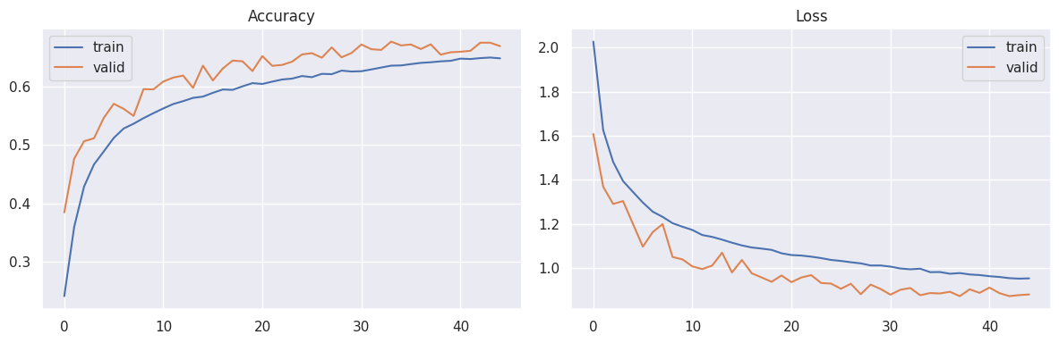
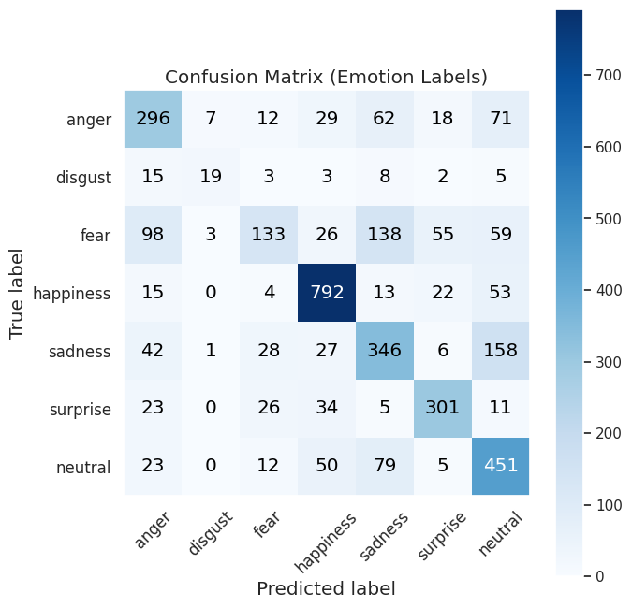
Deep CNN – Aug
Train = 64.84% , Valid = 66.93%, Test = 65.24

Slide 34
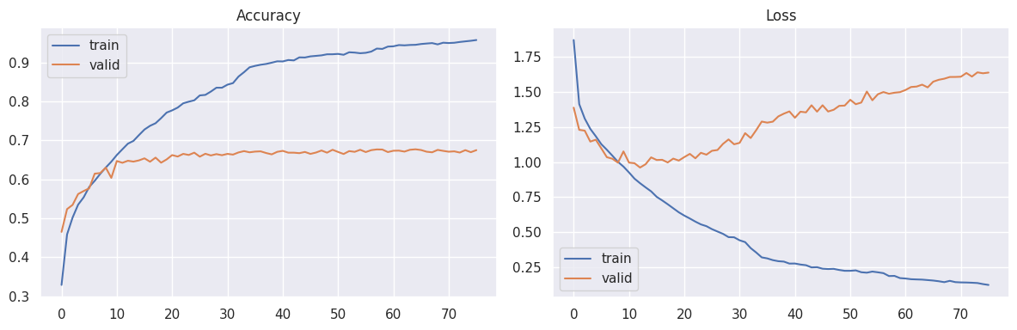
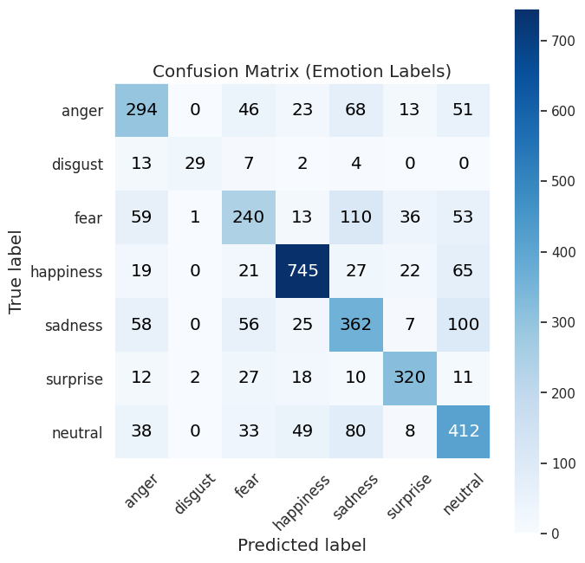
Deep CNN – HP Tune
Train = 95.76% , Valid = 67.49%, Test = 66.92

Slide 35
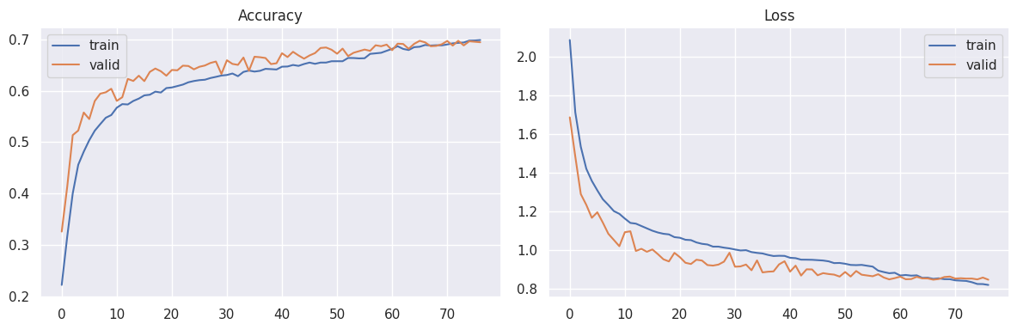

Deep CNN – Aug + HP Tune
Train = 69.84% , Valid = 69.41%, Test = 68.62%

Slide 36
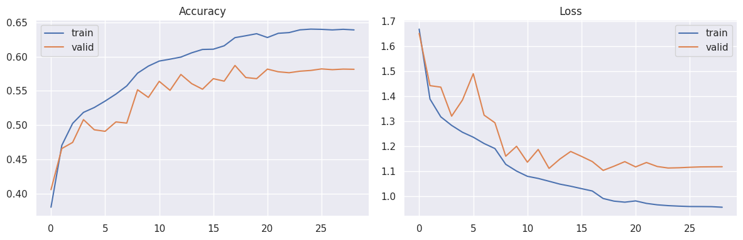
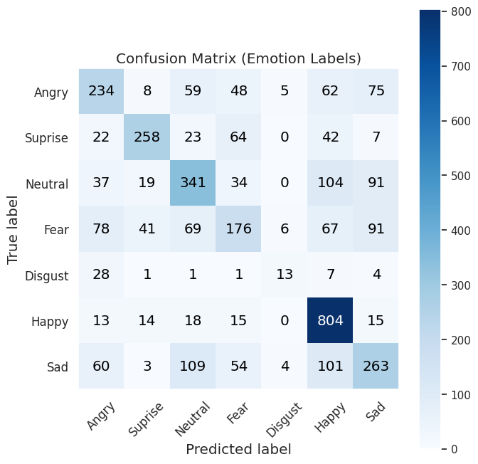
MobileNet
Train = 63.88% , Valid = 58.15%, Test = 58.19%

Slide 37
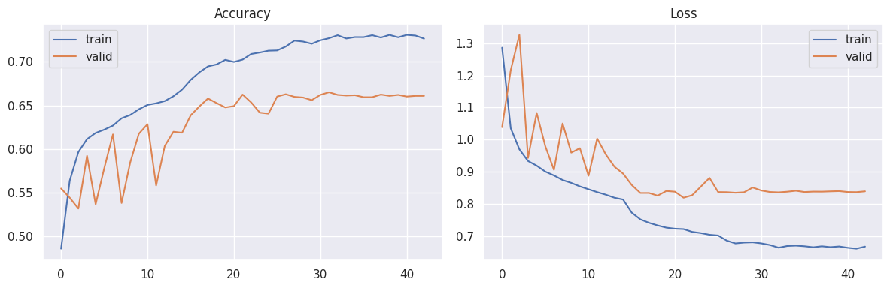
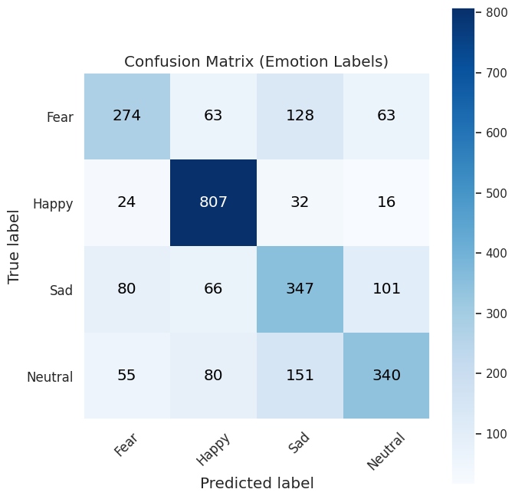
MobileNet – Four Emotions
Train = 72.63% , Valid = 66.09%, Test = 67.26%

Slide 38
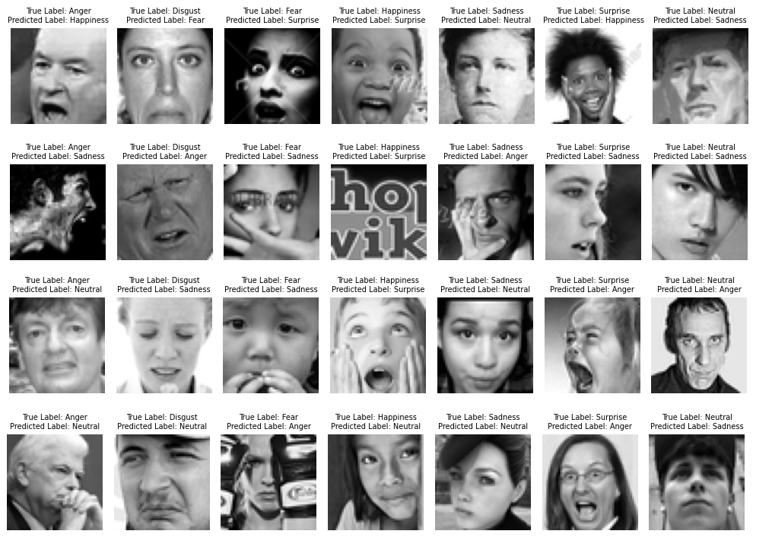
Misclassified Samples

Slide 39
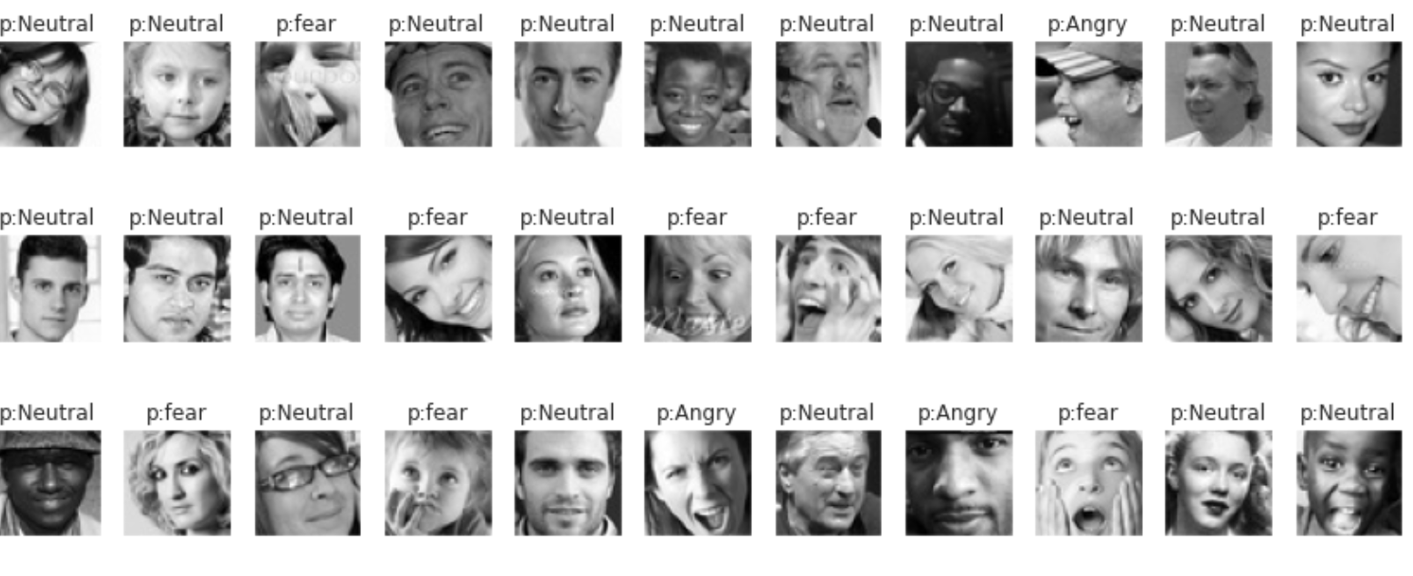
Misclassified “Happy” samples

Slide 40
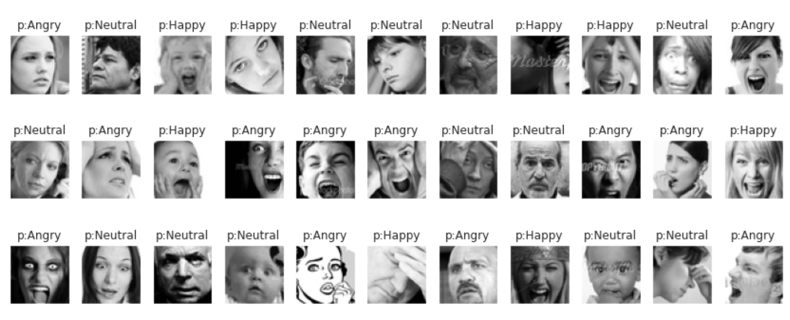
Misclassified “Fear” samples

Slide 41
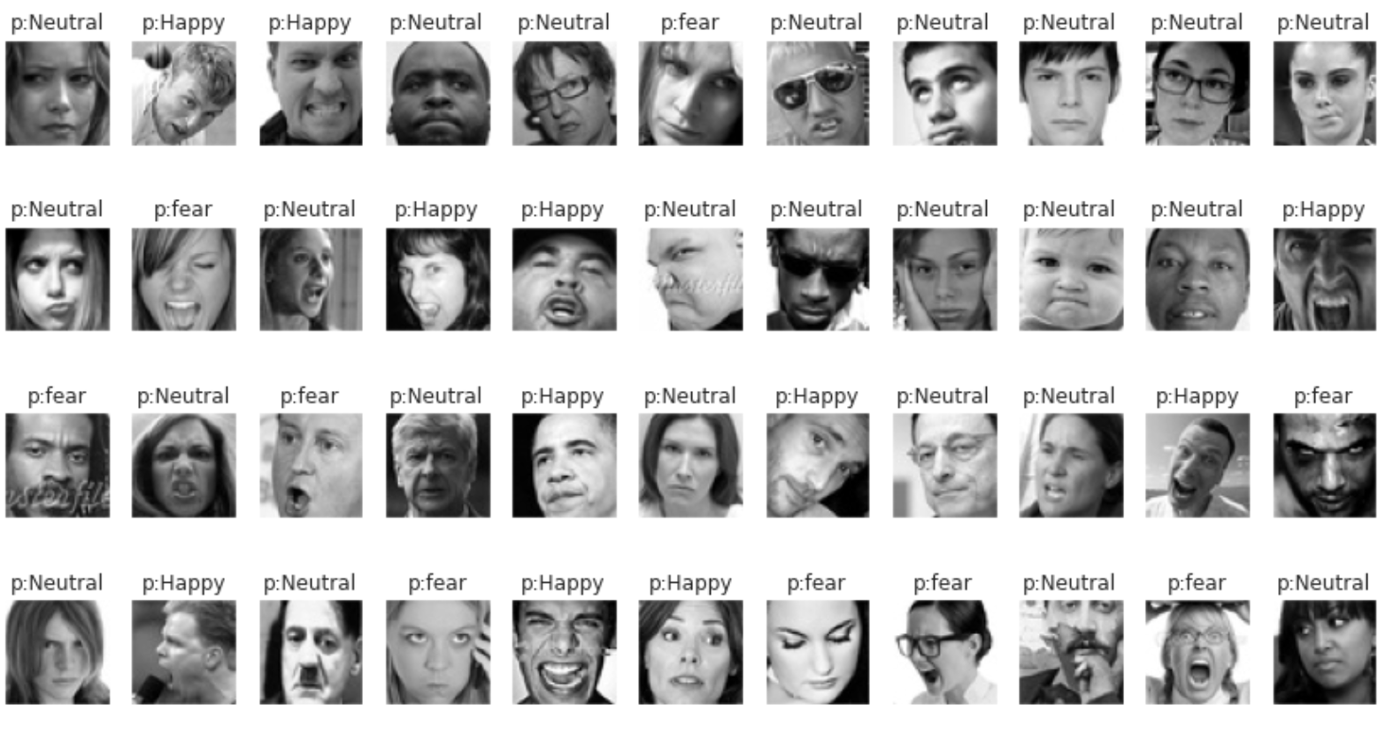
Misclassified “Angry” samples

Slide 42
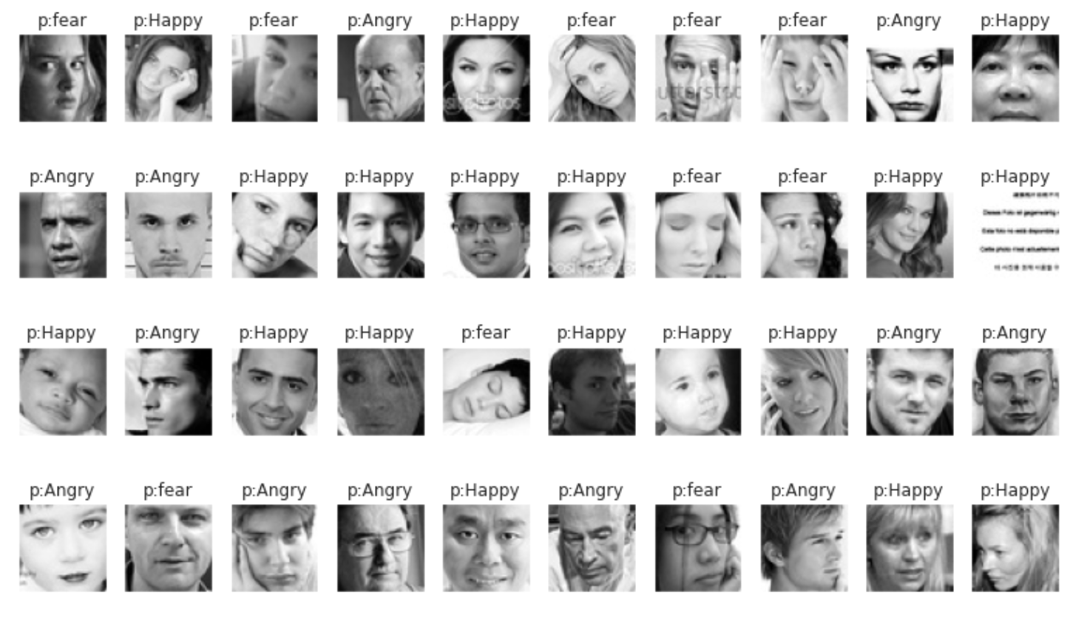
Misclassified “Neutral” samples

Slide 43
Selection of best model
Best Performing → Deep CNN with augmentation and hyperparameter tuning
CNN Model | Training accuracy w/augmentation | Test accuracy w/augmentation | Training accuracy w/o augmentation | Test accuracy w/o augmentation | Number of wrong test predictions W/Aug. | Number of wrong test predictions W/oAug.
Shallow CNN | 49.95 % | 56.2% | 60.09 % | 60.8% | 1566 | 1407
Shallow CNN w/H.T | 48.62% | 57.5% | 60.03 | 61.1% | 1524 | 1398
Deep CNN | 64.85% | 65.24% | 82.52% | 66% | 1251 | 1220
Deep CNN w/H.T | 69.84% | 68.62% | 95.76% | 66.92% | 1126 | 1187
MobileNet (allemotions) | 63.88% | 58.15% | - | - | 1500 | -
MobileNet (4emotions) | 72.63% | 66.09% | - | - | 859 | -

Slide 44
Real Time Live Demo

Slide 45
Contents
Introduction
Objective
Dataset and Problems
Methods and Implementation
Results
Conclusion
Outlook

Slide 46
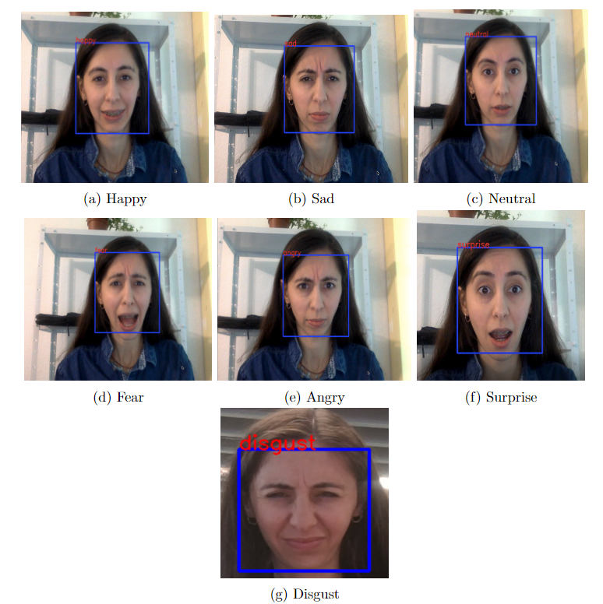
Conclusion
Deep CNN model outperformed others, achieving 68.62% accuracy
Augmentation and Hyperparameter tuning improved the model performance
Transfer learning with MobileNet didn't yield any better results
Deep CNN model was able to detect all seven emotions in real time video recording

Slide 47
Contents
Introduction
Objective
Dataset and Problems
Methods and Implementation
Results
Conclusion
Outlook

Slide 48
Outlook
Explore More Complex Architectures: Investigate and test more sophisticated network structures to potentially increase FER performance.
Further Hyperparameter Tuning: Experiment with other parameters of the developed Deep CNN model to potentially enhance overall accuracy.
Dataset Improvement: Enhance the quality of the dataset used in the project by:
Removing irrelevant images.
Addressing the contrast and occlusion problem
Balancing the representation of different emotions

Slide 49
References
P. Ekman, “Strong evidence for universals in facial expressions: a reply to russell’s mistaken critique.,” 1994.
K. Vemou and A. Horvath, “Techdispatch 1/2021 - facial emotion recognition.” https://edps.europa.eu/data-protection/our-work/publications/ techdispatch/techdispatch-12021-facial-emotion-recognition_en, 2021. [Accessed: May 13, 2023].
R. C. Gonzalez and R. E. Woods, Digital Image Processing. Upper Saddle River, NJ:Prentice Hall, 4th ed., 2018.
Challenges in representation learning: Facial expression recognition challenge.” https://www.kaggle.com/c/challenges-in-representation-learning-facial-expression-recognition-challenge. [Accessed on 23rd March 2023]
TensorFlow, “Imagedatagenerator.” https://www.tensorflow.org/api_docs/python/tf/keras/preprocessing/image/ImageDataGenerator, 2023. [Accessed on May 19, 2023]
What Is Transfer Learning? [Examples & Newbie-Friendly Guide].” V7labs.com, 2022, www.v7labs.com/blog/transfer-learning-guide. Accessed March 2023.
Wang, Wei, et al. "A novel image classification approach via dense-MobileNet models." Mobile Information Systems 2020 (2020).
Phiphitphatphaisit, Sirawan & Surinta, Olarik. (2020). Food Image Classification with Improved MobileNet Architecture and Data Augmentation.
A. G. Howard, M. Zhu, B. Chen, D. Kalenichenko, W. Wang, T. Weyand, M. Andreetto, and H. Adam, “Mobilenets: Efficient convolutional neural networks for mobile vision applications,” arXiv preprint arXiv:1704.04861, 2017.
K. Malialis, D. Papatheodoulou, S. Filippou, C. G. Panayiotou, and M. M. Polycarpou, “Data augmentation on-the-fly and active learning in data stream classification,” arXiv preprint arXiv:2210.06873, 2022.
Brilliant.org, “Convolutional neural network.” https://brilliant.org/wiki/convolutional-neural-network/, [Accessed on March 19, 2023].
P. with Code, “Max pooling.” https://paperswithcode.com/method/max-pooling. [Accessed on March 19, 2023]
Do, Synho et al. “Basics of Deep Learning: A Radiologist's Guide to Understanding Published Radiology Articles on Deep Learning.” Korean journal of radiology vol. 21,1 (2020): 33-41. doi:10.3348/kjr.2019.0312

Slide 50
Thank You !

Slide 52
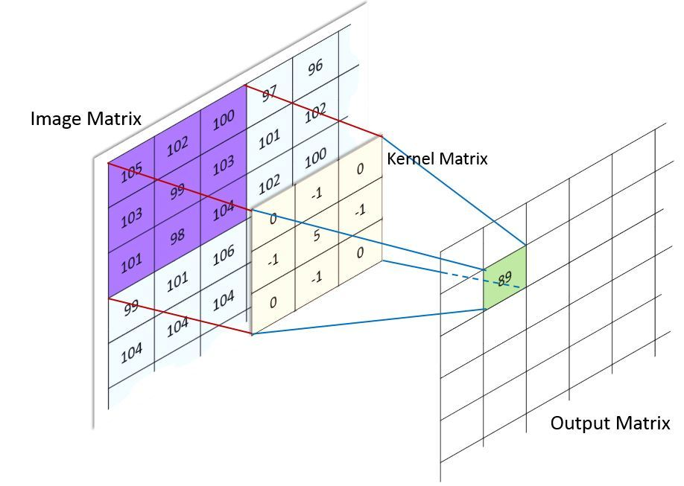
Source: Brilliant.org, “Convolutional neural network.” https://brilliant.org/wiki/convolutional-neural-network/.

Slide 53

Source: P. with Code, “Max pooling.” https://paperswithcode.com/method/max-pooling.

Slide 54

Source: Wang, Wei, et al. "A novel image classification approach via dense-MobileNet models." Mobile Information Systems 2020 (2020).

Slide 55
Part A
Part B
Facial emotion recognition using CNN
Real time face emotion recognition

Slide 56
Tools and Framework
Programming language : python 3.7
Data preprocessing: Numpy, Pandas, Scikit-Learn, Open CV (cv2)
Data visualization: Matplotlib and Seaborn
Architecture Design: Tensorflow and Keras
IDE: Google Colab , Jupyter Notebook

